Slide 1
ENRON NET WORKS
OPERATIONS TEAM (Gas)
281 Employees
Trading Support Provided
  Gas Logistics (51) - nominations and pipeline balancing
  Risk Management (61) - position and P/L reporting
  Volume Management (26) - pipeline actualization
  Physical & Financial Settlements (61) - invoice generation
  Other Teams (82) - Deal Validation, Global Data (contracts, facilities, Duns #’s), EOL, Deal Confirmations

Slide 2
GAS LOGISTICS FUNCTION
Primary Responsibilities
  Manage EA’s physical delivery of over 31BCF/day on 90 pipeline systems across North America
  Provide the commercial teams with timely and critical information to enhance trading opportunities
  Ensure EA’s business is captured accurately to minimize pipeline and customer invoice discrepancies
  Support EA’s new business by providing a superior level of customer service (asset transactions, outsourcing functions, internal support)
  Continuously explore and develop new and unique ways to manage the business to reduce O&M costs and reduce nomination processing time

Slide 3
MANAGING PHYSICAL DELIVERIES
Emphasis on systems and technology to trade, schedule and settle all physical transactions
  Trading and scheduling systems linked. EOL deals feed directly or trader enters a telephone trade, information is validated, scheduler instantly sees the deal in scheduling system and nominates to the pipeline, settlements and volume management teams pay and send invoices using the same scheduling system
  Majority of business is scheduled through the use of EDI (approx..75%). Continuous effort to bring the balance of pipelines up on EDI. Enron leads the industry in EDI use
  Traders and schedulers have access to trading and scheduling systems from remote locations to provide 24 hour coverage.
  Asset Management Deals
  4 Dedicated People
Electronic Commerce/GISB
  1 Director, 1 Staff
Project Unify
  1 Manager
  11 Full Time, 4 Part Time, 1 Contract
Annual O&M Budget over $4M

Slide 4
PEOPLES + ENA = ENOVATE
Enovate Trading done in Chicago Office utilizing the systems and support of EA’s Central Region Houston office
Enovate trades scheduled by EA Houston office with support of the Peoples scheduling team
24 hour scheduling coverage provided by EA’s Houston team directed by the Chicago and Houston traders
Invoices generated through the same process and systems used by EA

Slide 5
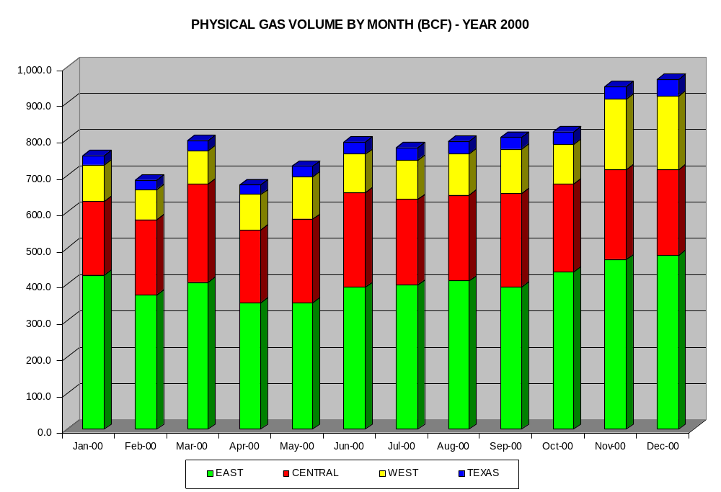
963 BCF

Slide 6
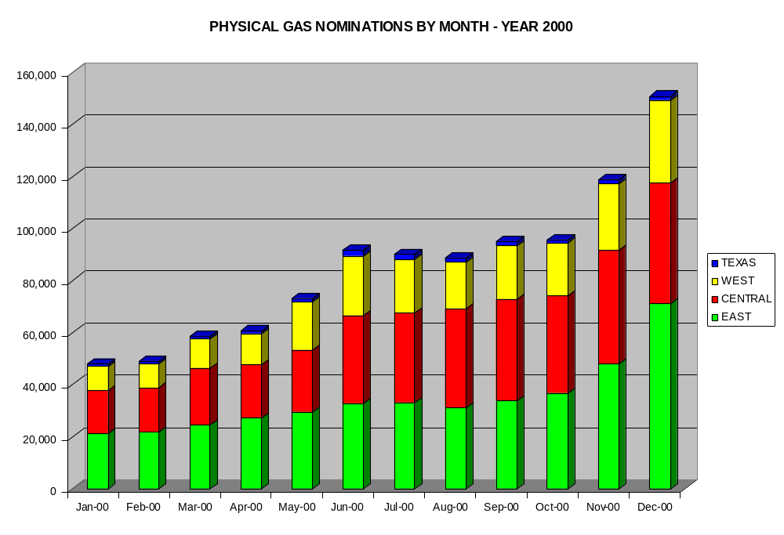
150,683

Slide 7
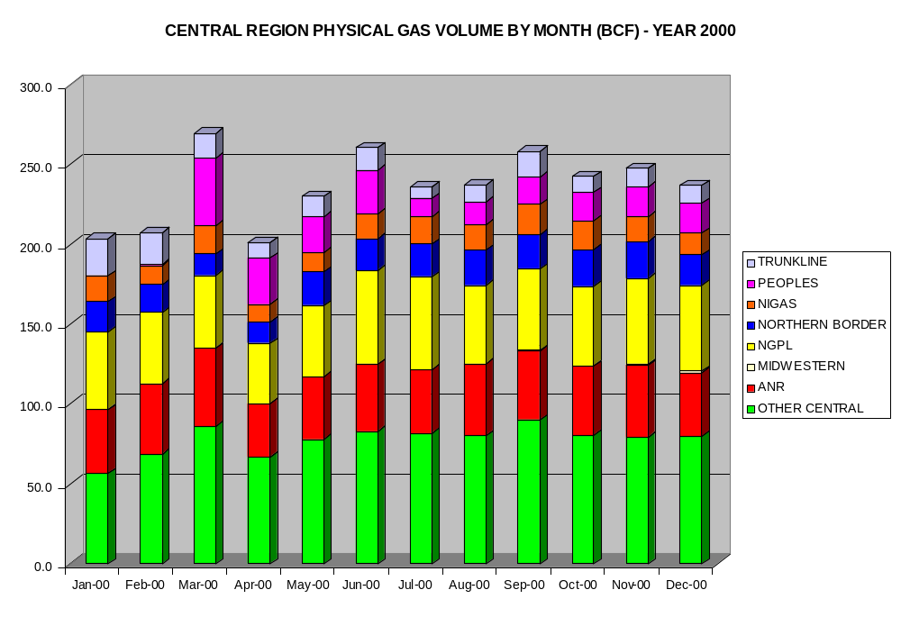
237 BCF

Slide 8
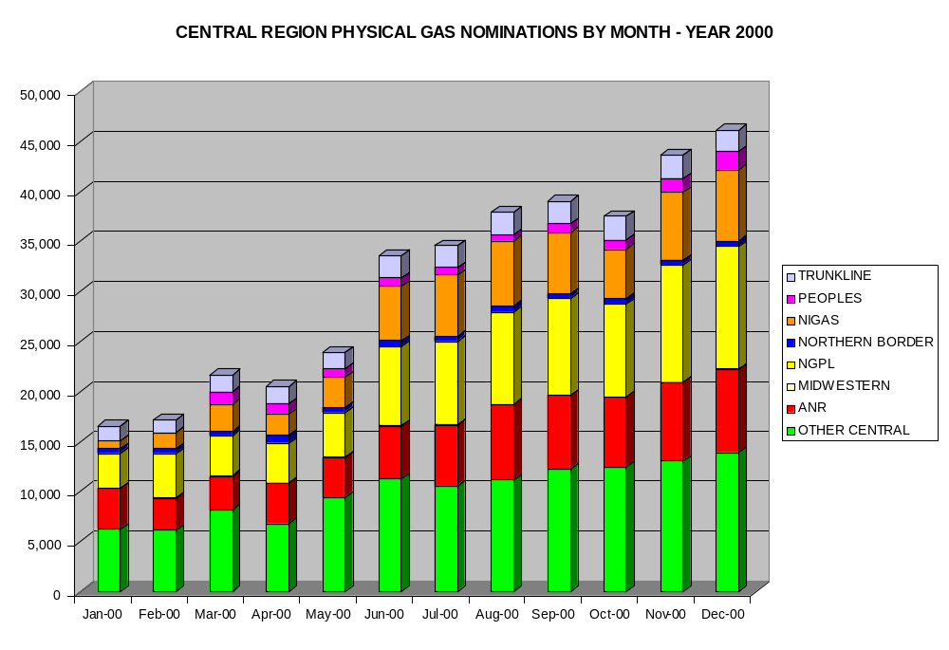
46,167

Slide 9
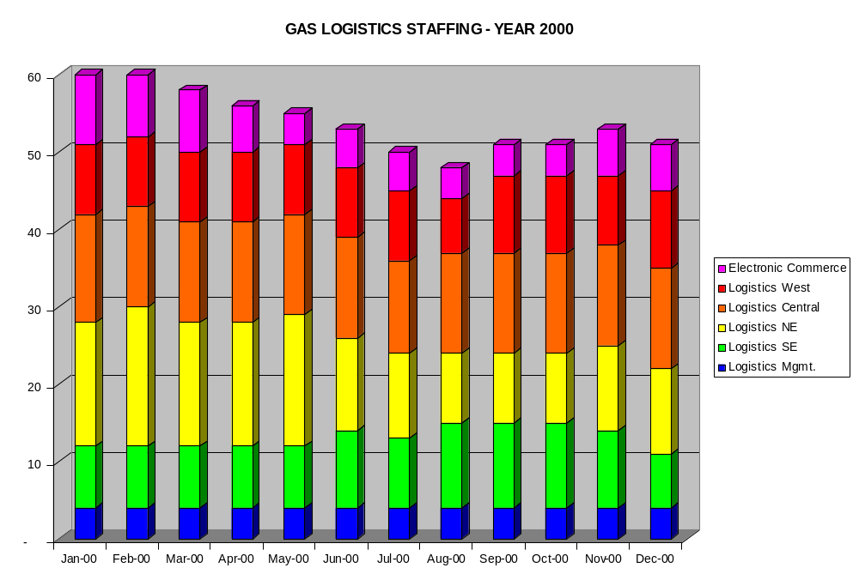

Slide 10
